Slide 1


OpenShift Sharks
Wireshark & tools

Slide 2
Installing Wireshark
Linux
# dnf install -y wireshark wireshark-cli
Mac
# brew install --cask wireshark
Windows
Simply download the Wireshark installer from https://www.wireshark.org/download.html and execute it.
Notes:
I want to change yourself on the philosophical level and ask yourself (how does the operator completes the cycle)

Slide 3

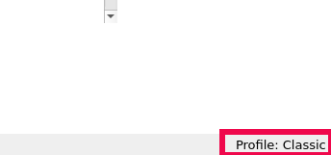
New Profile
Just like adjusting your car seat to fit your body requirements we need to setup our wireshark profile
On the button right corner we will “right-click” on the profile and then select “Manage Profiles”
Notes:
I want to change yourself on the philosophical level and ask yourself (how does the operator completes the cycle)

Slide 4
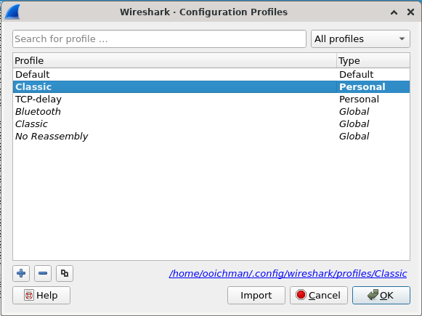
New Profile
Click on the plus sign and enter the name of your new profile
Notes:
I want to change yourself on the philosophical level and ask yourself (how does the operator completes the cycle)

Slide 5
Customizing wireshark (TCP)
Click on the plus sign and enter the name of your new profile
In case of TCP we would like to add 2 time columns , one from the beginning of the conversation and one sense the last frame
Change the layout
Show packet details as you prefer
Notes:
I want to change yourself on the philosophical level and ask yourself (how does the operator completes the cycle)

Slide 6
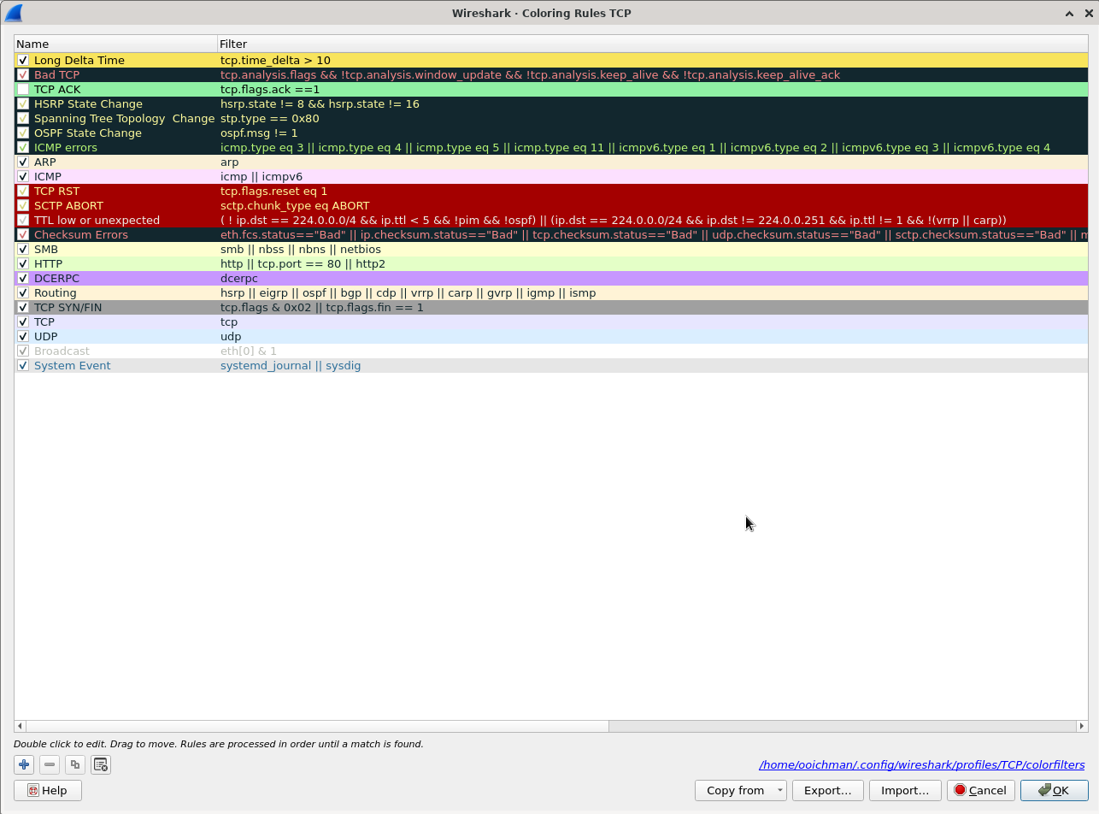
wireshark Coloring rows (TCP)
Wireshark can color special rows to make it easier to investigate
Under “view” → “coloring rules”
For TCP we can create a role that will color the “ack” packet
Color the delta time from the last packet if it’s bigger the 10 sec in Yellow
Notes:
I want to change yourself on the philosophical level and ask yourself (how does the operator completes the cycle)

Slide 7
Customizing wireshark (UDP)
Click on the plus sign and enter the name of your new profile
In case of UDP we would like to add 2 time columns , one from the beginning of the conversation and one sense the last frame
Change the layout
Show packet details as you prefer
Notes:
I want to change yourself on the philosophical level and ask yourself (how does the operator completes the cycle)

Slide 8
Get into OpenShift !!!
Red Hat is the world’s leading provider of enterprise open source software solutions. Award-winning support, training, and consulting services make Red Hat a trusted adviser to the Fortune 500.

